Slide 1

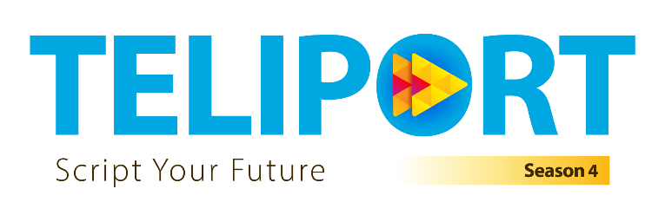
FlairGuard AI: Closed-Loop Self-Healing Telemetry
Tata Elxsi Teliport S4
Case Study 1: ACTG — Predictive Maintenance

Slide 2
CASE STUDY 1: ACTG - PREDICTIVE MAINTENANCE
End-to-End System Architecture: Closed-Loop Fleet Maintenance
1. Data Engineering
2. Predictive ML Engine
3. Non-LLM Triage Agent
4. MLOps & Continuous Loop
• NASA C-MAPSS Telemetry Ingestion (21 Sensors + 3 Settings).
• Strict causality: Group-wise rolling means (w=5, 20) with no future lookahead.
• Engine ID isolation: 80/20 train/validation disjoint split.
• Zero-variance sensor filtering (sensors 1, 5, 10, 16, 18, 19 in FD001).
• Dual-engine approach: Degradation Anomaly Detection + RUL Regression.
• Piecewise Linear RUL Target: Capped at 125 cycles (healthy vs wear phases).
• Benchmarked 4 Models: Ridge, Random Forest, HistGradientBoosting, LightGBM.
• Validation-only selection: Official NASA test set evaluated strictly once.
• Lightweight, deterministic rule engine running with sub-millisecond latency.
• Risk matrix: Combines RUL prediction + anomaly persistence.
• Automated Severity Assignment: P1 Critical (RUL < 15), P2 High (15-30), P3 Medium (30-50).
• Generates CMMS work orders with duplicate suppression & audit logs.
• Experiment tracking: MAE, RMSE, and NASA PHM08 asymmetric loss.
• Automated retraining trigger on fleet data distribution drift.
• Human-in-the-Loop exception handling for borderline confidence.
• Modular architecture ready for multi-regime scaling (FD002–FD004).

Slide 3
CASE STUDY 1: ACTG - PREDICTIVE MAINTENANCE
Data Engineering: Causal Integrity & Leakage Prevention
Causal Feature Engineering Principles
Physics-Informed Preprocessing
• Elimination of Lookahead Bias: In operational fleets, future cycles do not exist. Features at cycle 't' are computed strictly from historical cycles (1 to t) for that engine.
• Causal Rolling Statistics: Rolling window aggregations (w=5, 20) capture degradation acceleration without leaking future engine state.
• Group-Disjoint Splits: Standard random row splitting causes severe engine data leakage. FlairGuard groups strictly by engine_id (80 fit / 20 validation engines).
• Defensive Ingestion: Validates monotonic cycles, schema completeness, and verifies non-negative finite telemetry across all engines.
• Piecewise Linear Degradation: Real turbofans do not degrade linearly from day one. Wear initiates after initial cycles; RUL target is capped at 125 cycles during training.
• Regime & Sensor Invariance: Flat sensors with negligible variance in single-operating conditions are pruned to prevent ill-conditioned covariance matrices in linear models.
• Uncapped Official Testing: Test ground truth remains unclipped (evaluating up to 140+ cycles) to ensure honest, unadulterated NASA benchmark metrics.
• Automated Property Testing: 8 pytest unit tests enforce strict causality, engine isolation, and reproducible metrics.

Slide 4
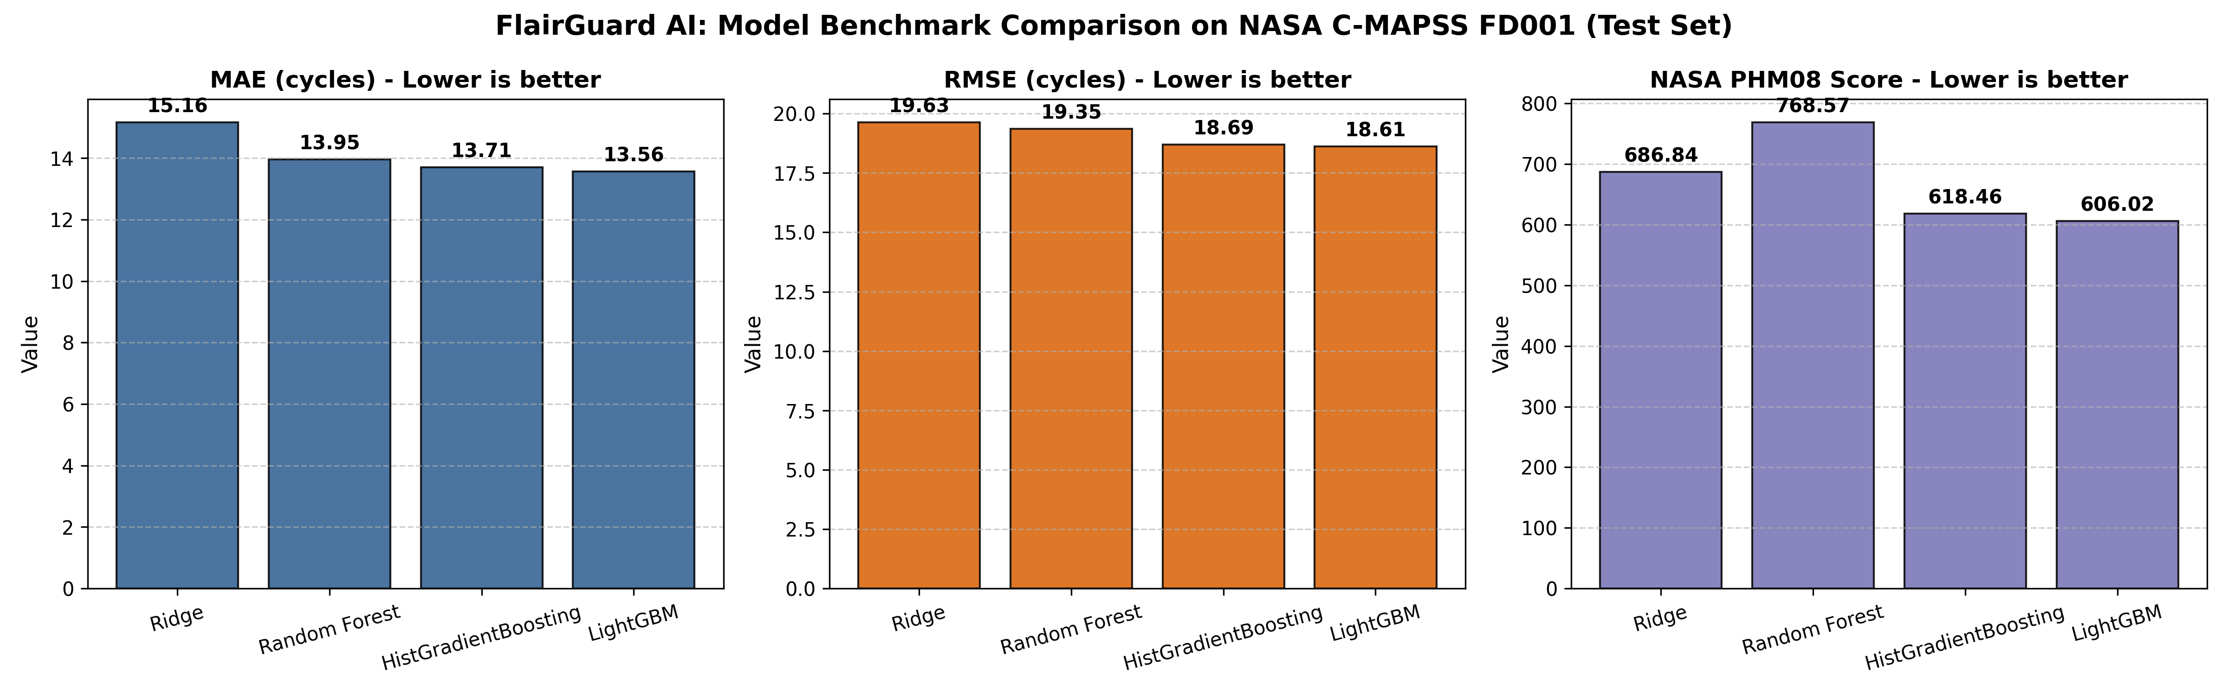
CASE STUDY 1: ACTG - PREDICTIVE MAINTENANCE
Empirical ML Benchmarking on NASA C-MAPSS FD001
Model | FD001 MAE | FD001 RMSE | NASA PHM08 Score
Ridge (L2 Baseline) | 15.16 | 19.63 | 686.84
Random Forest | 13.95 | 19.35 | 768.57
HistGradientBoosting | 13.71 | 18.69 | 618.46
LightGBM (Selected) | 13.56 | 18.61 | 606.02
Benchmark Analysis & Model Selection
• LightGBM achieved the best overall performance with MAE of 13.56 cycles, RMSE of 18.61 cycles, and lowest NASA Score of 606.02.
• NASA PHM08 Metric: Heavily penalizes late predictions (predicting engine will survive longer than it does). LightGBM minimized catastrophic late failures.
• Zero Test Peeking: Selection was governed entirely by held-out validation engine scores; official test set was evaluated strictly once for final reporting.

Slide 5
CASE STUDY 1: ACTG - PREDICTIVE MAINTENANCE
Lightweight Non-LLM Triage Agent & Closed-Loop Actions
Deterministic Decision Logic (No LLM Required)
Human-in-the-Loop & Auditability
• Why Non-LLM? Telemetry decision loops require sub-second deterministic reliability, zero hallucination risk, and strict auditability under regulatory standards.
• Multi-Tier Severity Triage:
• Critical (P1): RUL <= 15 cycles or persistent high-magnitude sensor anomaly. Generates immediate maintenance work order with expedited parts routing.
• High (P2): 15 < RUL <= 30 cycles. Schedules priority servicing within 48 hours.
• Medium (P3): 30 < RUL <= 50 cycles. Alerts fleet maintenance planner for routine scheduling.
• Nominal (P4): RUL > 50 cycles. Continuous monitoring status.
• Work Order Deduplication: Prevents alert flooding by maintaining active work order hash states per engine.
• Automated CMMS Work Order Schema: Generates structured JSON/PDF work order containing engine ID, current cycle, predicted RUL, primary degrading sensor, and assigned technician role.
• Exception Escalation: When anomaly detector flags high divergence but regression predicts healthy RUL (model conflict), the agent escalates to senior reliability engineers for manual inspection.
• Audit Trail: Complete decision logs recorded with timestamp, model version, and exact input telemetry snapshot for full traceability.
• Closed-Loop Resolution: Fleet supervisor confirms or closes work order, providing ground truth feedback to the MLOps retraining pool.

Slide 6
CASE STUDY 1: ACTG - PREDICTIVE MAINTENANCE
MLOps Architecture & Multi-Regime Scaling Strategy
MLOps Pipeline & Continuous Retraining
Roadmap for FD002–FD004 (Multi-Regime Telemetry)
• Model Registry & Versioning: Tracks candidate model weights, hyperparameters, and experiment artifacts across iterations.
• Drift Monitoring: Monitors Kolmogorov-Smirnov test statistics on incoming sensor streams against baseline distributions.
• Automated Retraining Trigger: Automatically initiates retraining pipeline when:
• New run-to-failure engines reach maintenance completion.
• Feature drift score exceeds critical tolerance thresholds.
• Model validation error degrades past predetermined bounds.
• Production Serving: Lightweight serialized LightGBM artifacts deliver inference in under 5 milliseconds per telemetry snapshot.
• FD001 vs Multi-Regime Challenge: FD001 has 1 operating condition and 1 fault mode. FD002 & FD004 have 6 operating conditions, causing sensor values to swing based on altitude/Mach rather than wear.
• Regime-Aware Normalization: K-Means operating condition clustering on settings (altitude, Mach, throttle) followed by cluster-specific standard scaling.
• Ensemble Scaling: Dual-mode degradations (HPC & fan degradation in FD003/FD004) handled via multi-head gradient boosting or temporal sequence models (GRU/LSTM).
• Interactive Monitoring UI: Streamlit fleet dashboard for real-time fleet health visibility and work-order management (Round 2 PoC).

